Slide 1
Principal Components Analysis

Slide 2
Today . . .
  Identification of outliers
  Verifying multivariate normality

Slide 3
Principal components analysis can be used to screen the data for outliers, especially cases that may not be univariate outliers but are unusual in the multivariate sense.
To provide a comparison, we will first examine data that does not contain outliers. The data (N = 250) are generated from a multivariate normal distribution with 9 variables. Later we will replace the last case with a multivariate outlier.

Slide 4
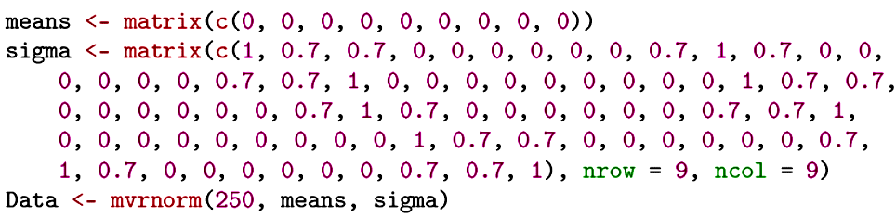
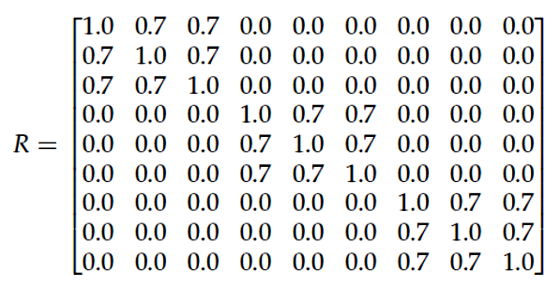
The generated data will fit this pattern, especially as sample size increases.

Slide 5
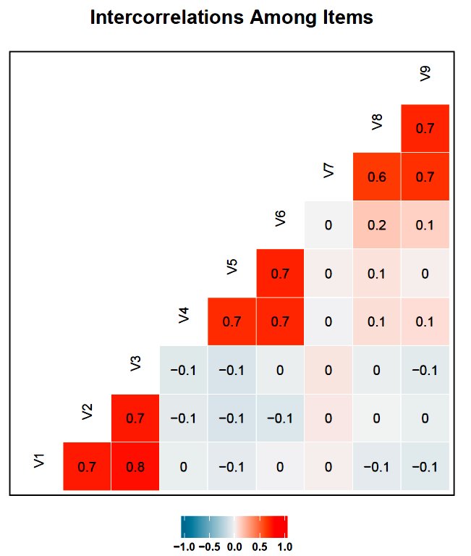
The intended correlations exist in the sample and the pattern of correlations suggests that three independent linear combinations likely will account for the 9 variables.

Slide 6
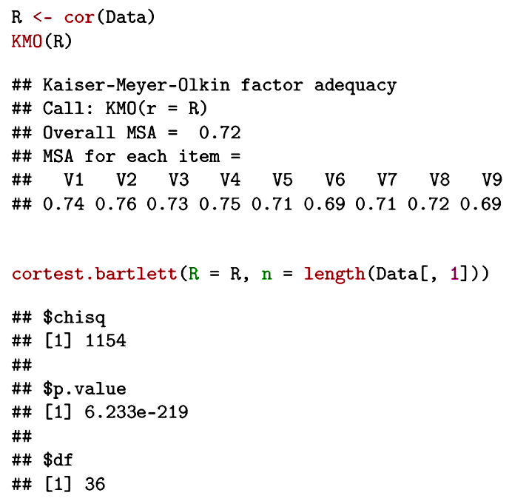
Both the KMO and Bartlett tests indicate that the correlation matrix departs from an identity matrix.

Slide 7
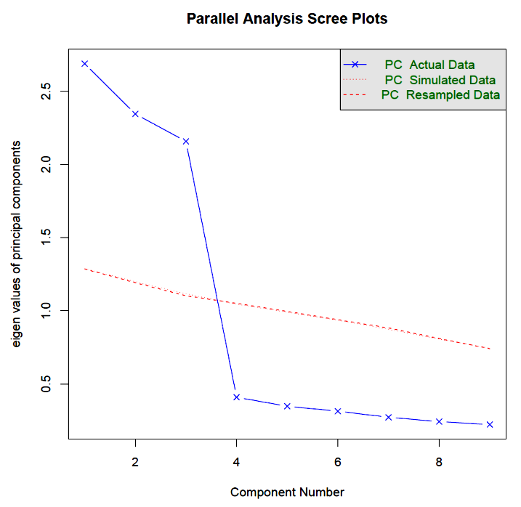
The scree test indicates that three components should be extracted from the data. Beyond three components, the eigenvalues suggest randomness.

Slide 8
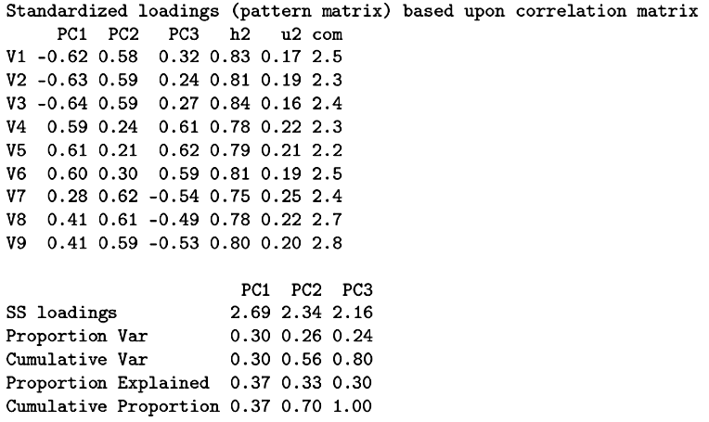
The components account for 80% of the original score variance.
Note that the principal component loadings do not suggest simple interpretations; that will require an additional transformation.
Notes:
Rotation is not necessary for our purposes.

Slide 9
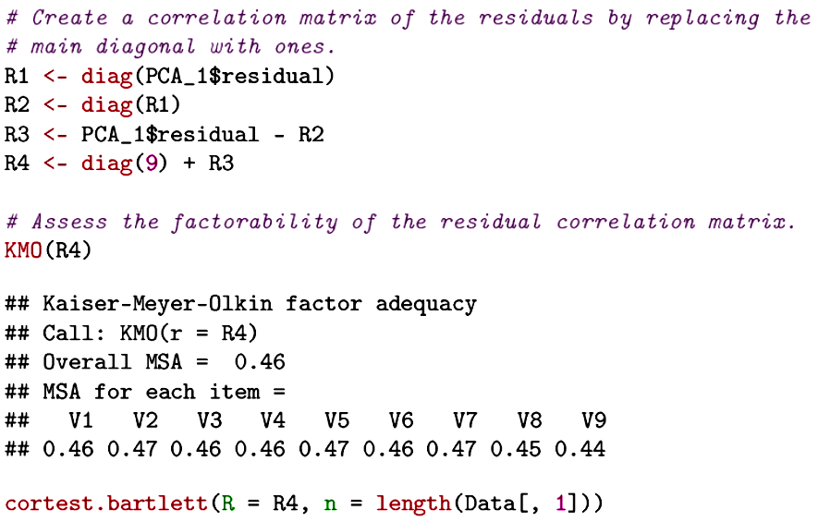
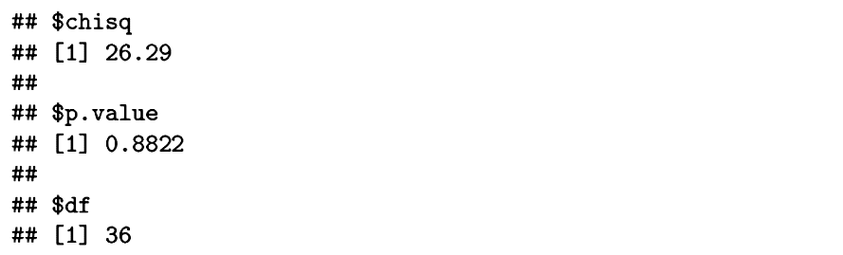
Once the three components are removed, there is no additional meaningful variability.

Slide 10
The data are in standard score form to make interpretation easy. The last case was replaced with a profile that made it unusual in the multivariate sense, though not terribly deviant in the univariate sense:
Variable 1: 3
Variable 2: -3
Variable 3: 3
Variable 4: -3
Variable 5: 3
Variable 6: -3
Variable 7: 3
Variable 8: -3
Variable 9: 3
In a sample this large, such values would be expected, but probably not for the same case and certainly not in this pattern.

Slide 11
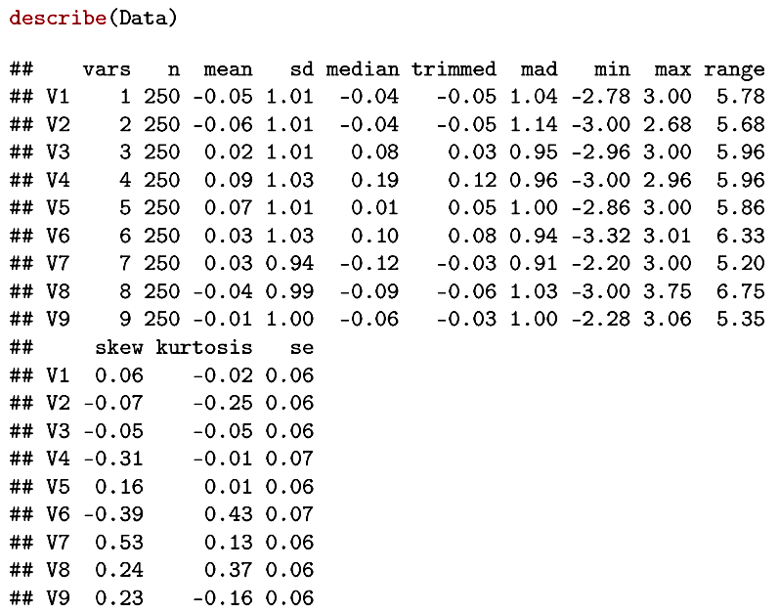
The univariate outliers do not distort the descriptive statistics in any obvious way. The case with the odd profile does not have the most extreme scores for some of the variables.

Slide 12
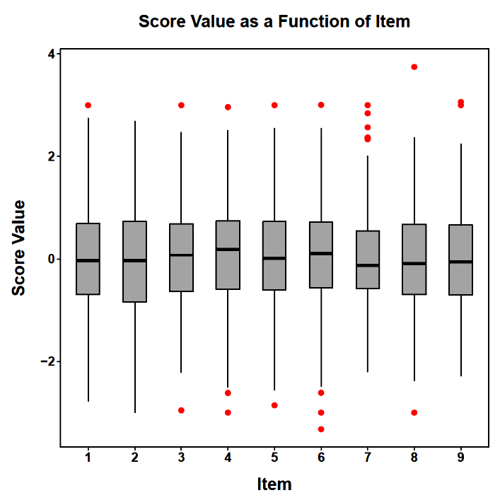
Visual displays do not reveal any particular problems.

Slide 13
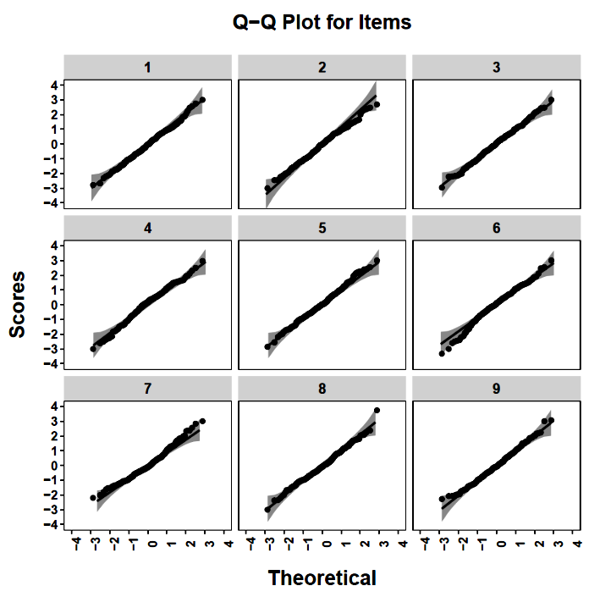
The data look embarrassingly normal.

Slide 14
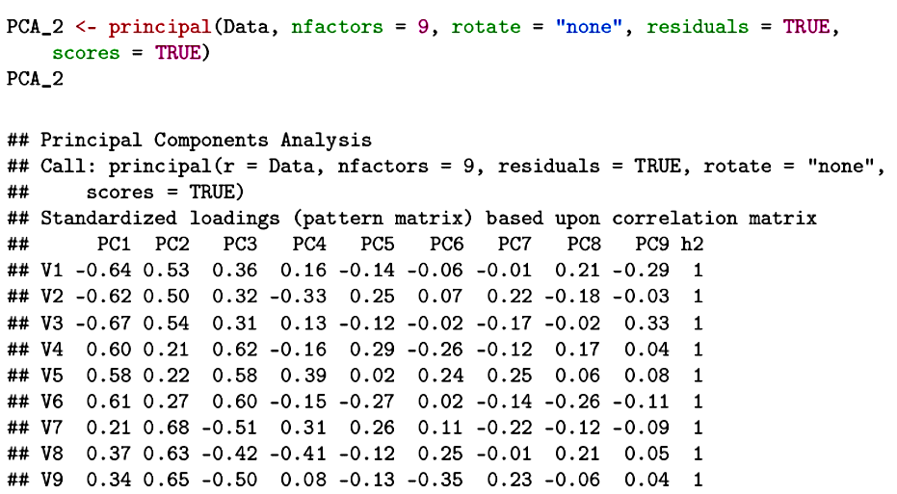
Here we extract all 9 principal components to see if the multivariate outlier reveals itself in these linear combinations. Our goal is not data reduction.

Slide 15

A principal components analysis will seek linear combinations that capture the major sources of variance in the data. Most of these will be governed by the "well-behaved" data. But, once that variation is captured, especially deviant multivariate cases may dominant the smaller components and emerge more readily.
For outlier detection, all components are derived and component scores are produced. Then diagnostics are performed on the component scores.

Slide 16
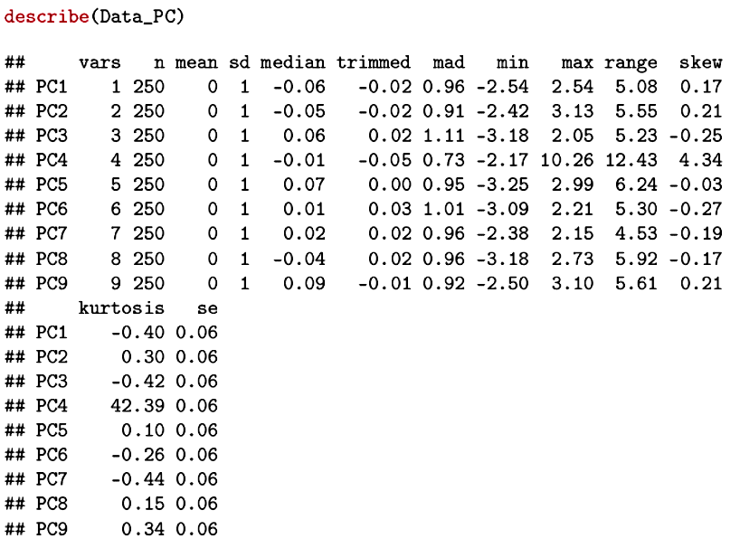
Problems are now readily apparent.
Approximate standard errors for skew and kurtosis are (6/N)^{1/2} and (24/N)^{1/2}, respectively (.15 and .31).

Slide 17
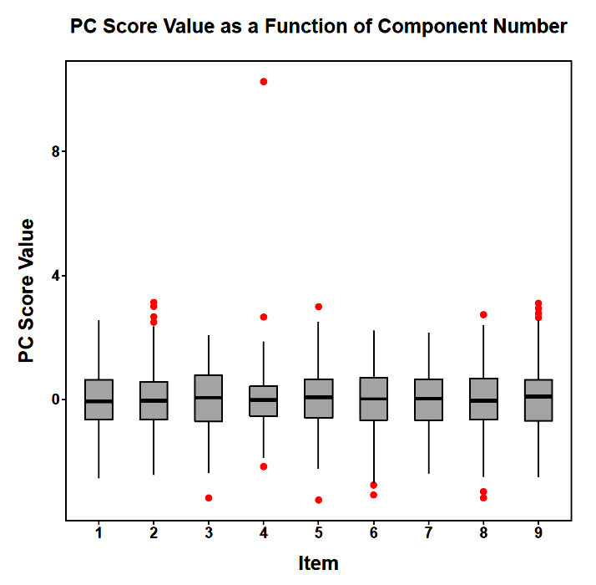
A visual display of the component scores shows a clear problem with Component 4.

Slide 18
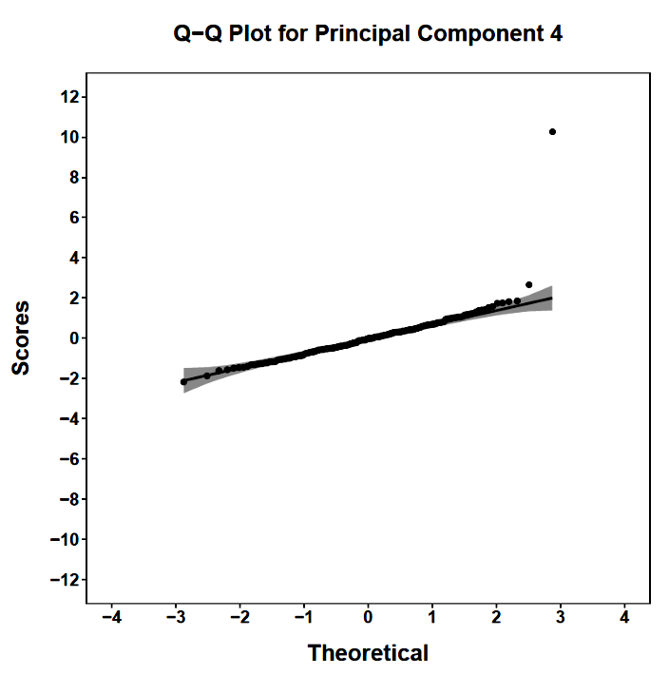
A visual display of the component scores shows a clear problem with Component 4.

Slide 19
Once identified, a multivariate outlier must be dealt with in some way.
  Transformation (probably will not help)
  Elimination (requires strong justification)
  Sensitivity analysis

Slide 20
In univariate statistics, the normality assumption underlies significance testing. It is with reference to sampling from some theoretical distribution that we can make claims about the likelihood of results occurring “by chance” or “under the null hypothesis.” Similarly, the establishment of confidence intervals depends on distributional assumptions.

Slide 21
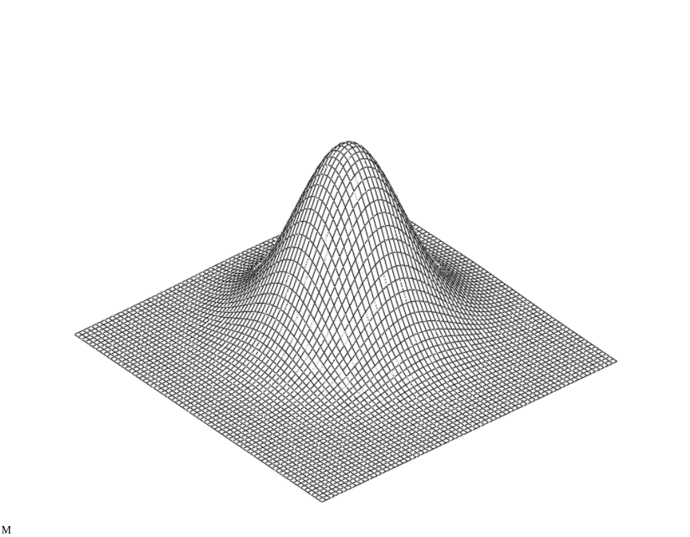
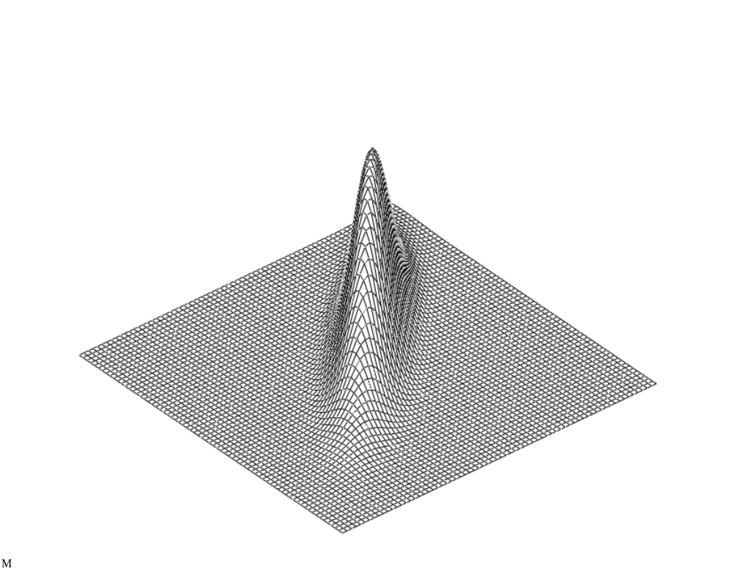
Underlying many multivariate procedures is the assumption of multivariate normality. This assumption extends the idea of bivariate normality to more than two dimensions. In bivariate normality, the distribution of one variable is normal for all values of the other variable, even when the variables are highly correlated.

Slide 22
When multivariate normality holds:
All marginal distributions will be normal.
All pairs of variables will be bivariate normal.
All linear combinations will be normal.
All pairs of linear combinations will be bivariate normal.
Squared distances from the population centroid will be chi-square distributed with k (k =number of variables) degrees of freedom.
Violating any of these is a violation of multivariate normality.

Slide 23
All linear combinations will be normal
It is not practical to test all linear combinations—there are an infinite number of them. But, testing a small number of commonly used linear combinations is important. The most commonly tested:
  Sum of all measures
  Pair-wise differences
  Principal components

Slide 24
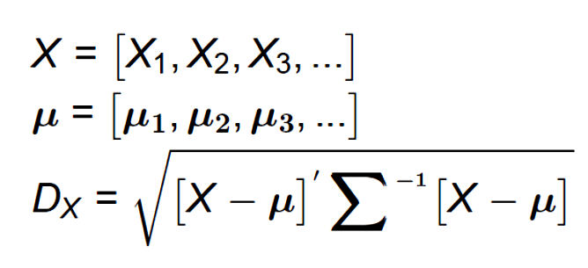
The distance of each case from the multivariate mean is indicated by the Mahalanobis distance:
Mahalanobis distance squared is χ² distributed with degrees of freedom equal to the number of measures (here df = 9).

Slide 25
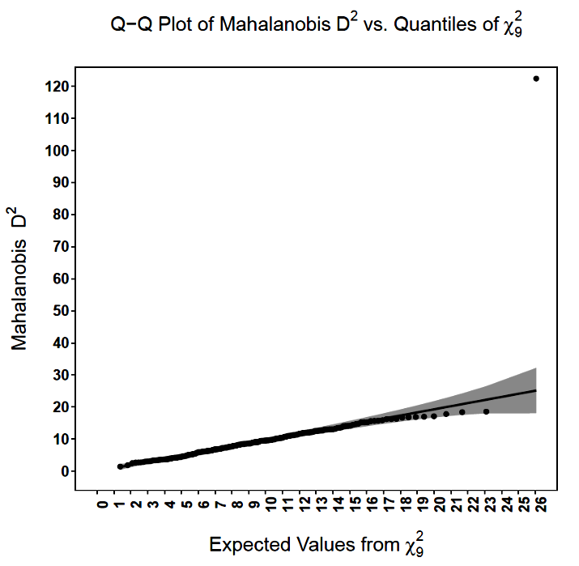
Mahalanobis distance provides a clear indication that something is amiss.

Slide 26
The general formula for Mahalanobis distance:
How is this simplified when applied to principal component scores?

Slide 27
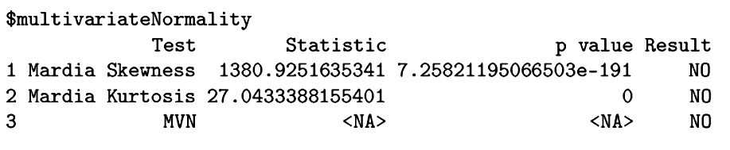
Several direct tests of multivariate normality are available (in the MVN package), but they need not agree and are overly sensitive with large N.

Slide 28
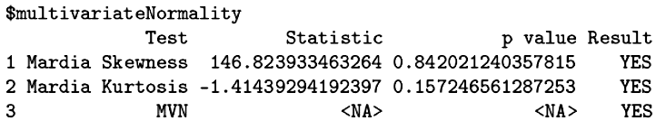
The original data, without the outlier, passes the multivariate normality test. As with other significance tests, minor violations will be detected as significant as sample size increases.

Slide 29
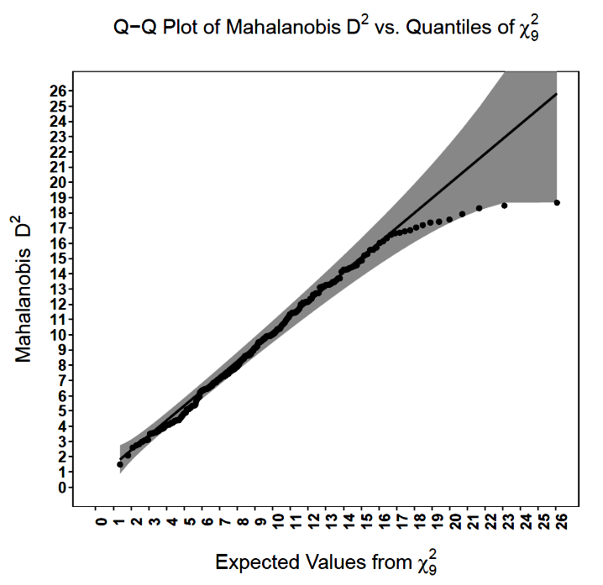
The original data, without the outlier, passes the multivariate normality test.

Slide 30
Violations of multivariate normality can be handled in multiple ways:
  Transformations
  Robust methods
  Resampling

Slide 31
Next time . . .
Simplified composites, group contamination, reducing multicollinearity, and some PCA-related methods.

